Slide 1
adxl345 accelerometer
Thomas Aziz
CENG317 Fall 2019
Smartwatch project

Slide 2
Introduction
The ADXL345 is a low-power, 3-axis accelerometer with both I2C and SPI interfaces. The sensor is soldered on to a custom-designed PCB that allows for plug-and-play operation with my chosen development platform – the Raspberry Pi 3.
Firmware was written to interface with the sensor, and the entire assembly is housed within a custom laser-cut acrylic enclosure.
This sensor will be integrated into a working SmartWatch device in Winter 2020.

Slide 3
Budget
The total cost for this project, assuming no items are already owned, was $316.90. The Pi and the sensor makes up the majority of the cost – totaling up to $122.79 (~40% of total cost).
I owned most of the items required going into the project, so my total personal cost was only $61.55.

Slide 4
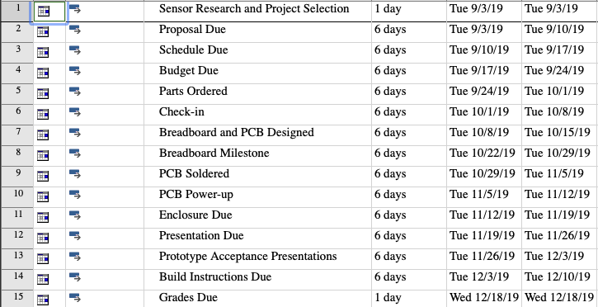
Schedule
The project was divided into a set of 14 weekly milestones
Most milestones were completed during our weekly 160 minute classes, with a few (namely PCB and soldering) requiring time commitments outside class
Estimated total time commitment: 14-17 hours
Project can be completed within one weekend assuming all items are owned or acquired prior to starting

Slide 5
Previous course knowledge
CENG252 – Embedded Systems: Interfacing with a physical hardware sensor, setting up a development platform, maintaining a Git repository
CENG150 – Electronic Circuits: Designing and setting up physical circuits using breadboards and wires
CENG 256 – Internet Programming: Python familiarity for writing firmware code

Slide 6
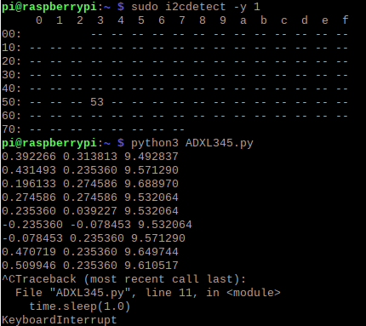
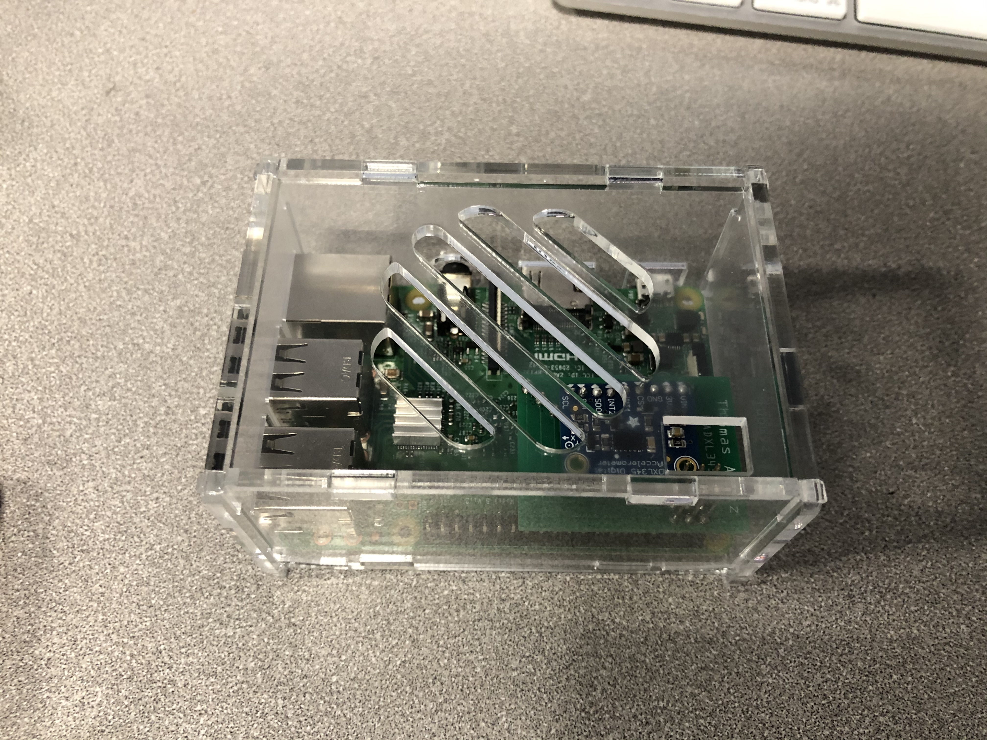
Project Images
Final product within enclosure
Sensor and Firmware Testing

